Slide 1
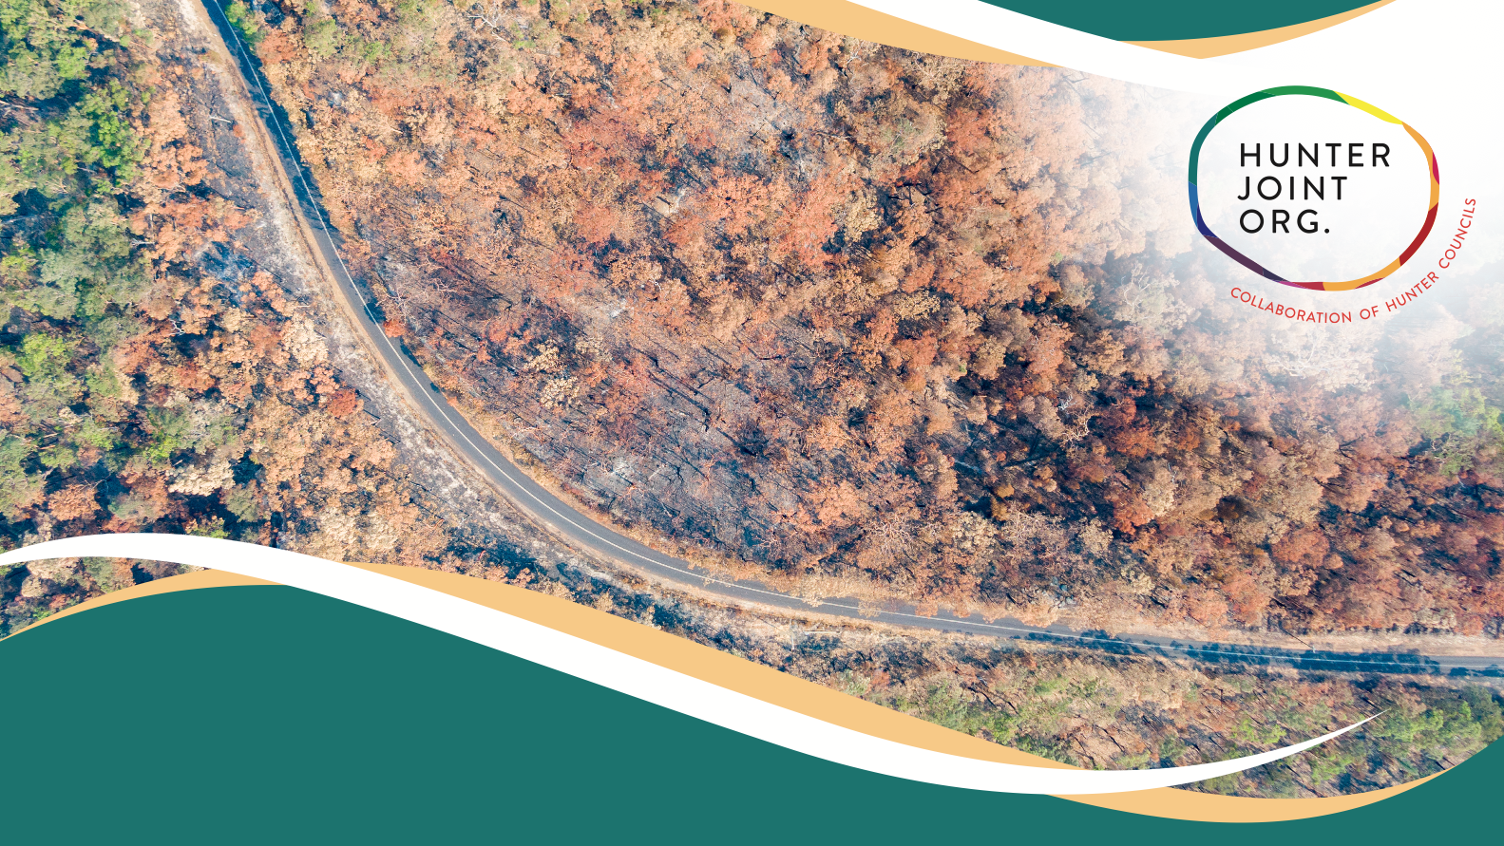
Council’s Resilience Commitments

Slide 2
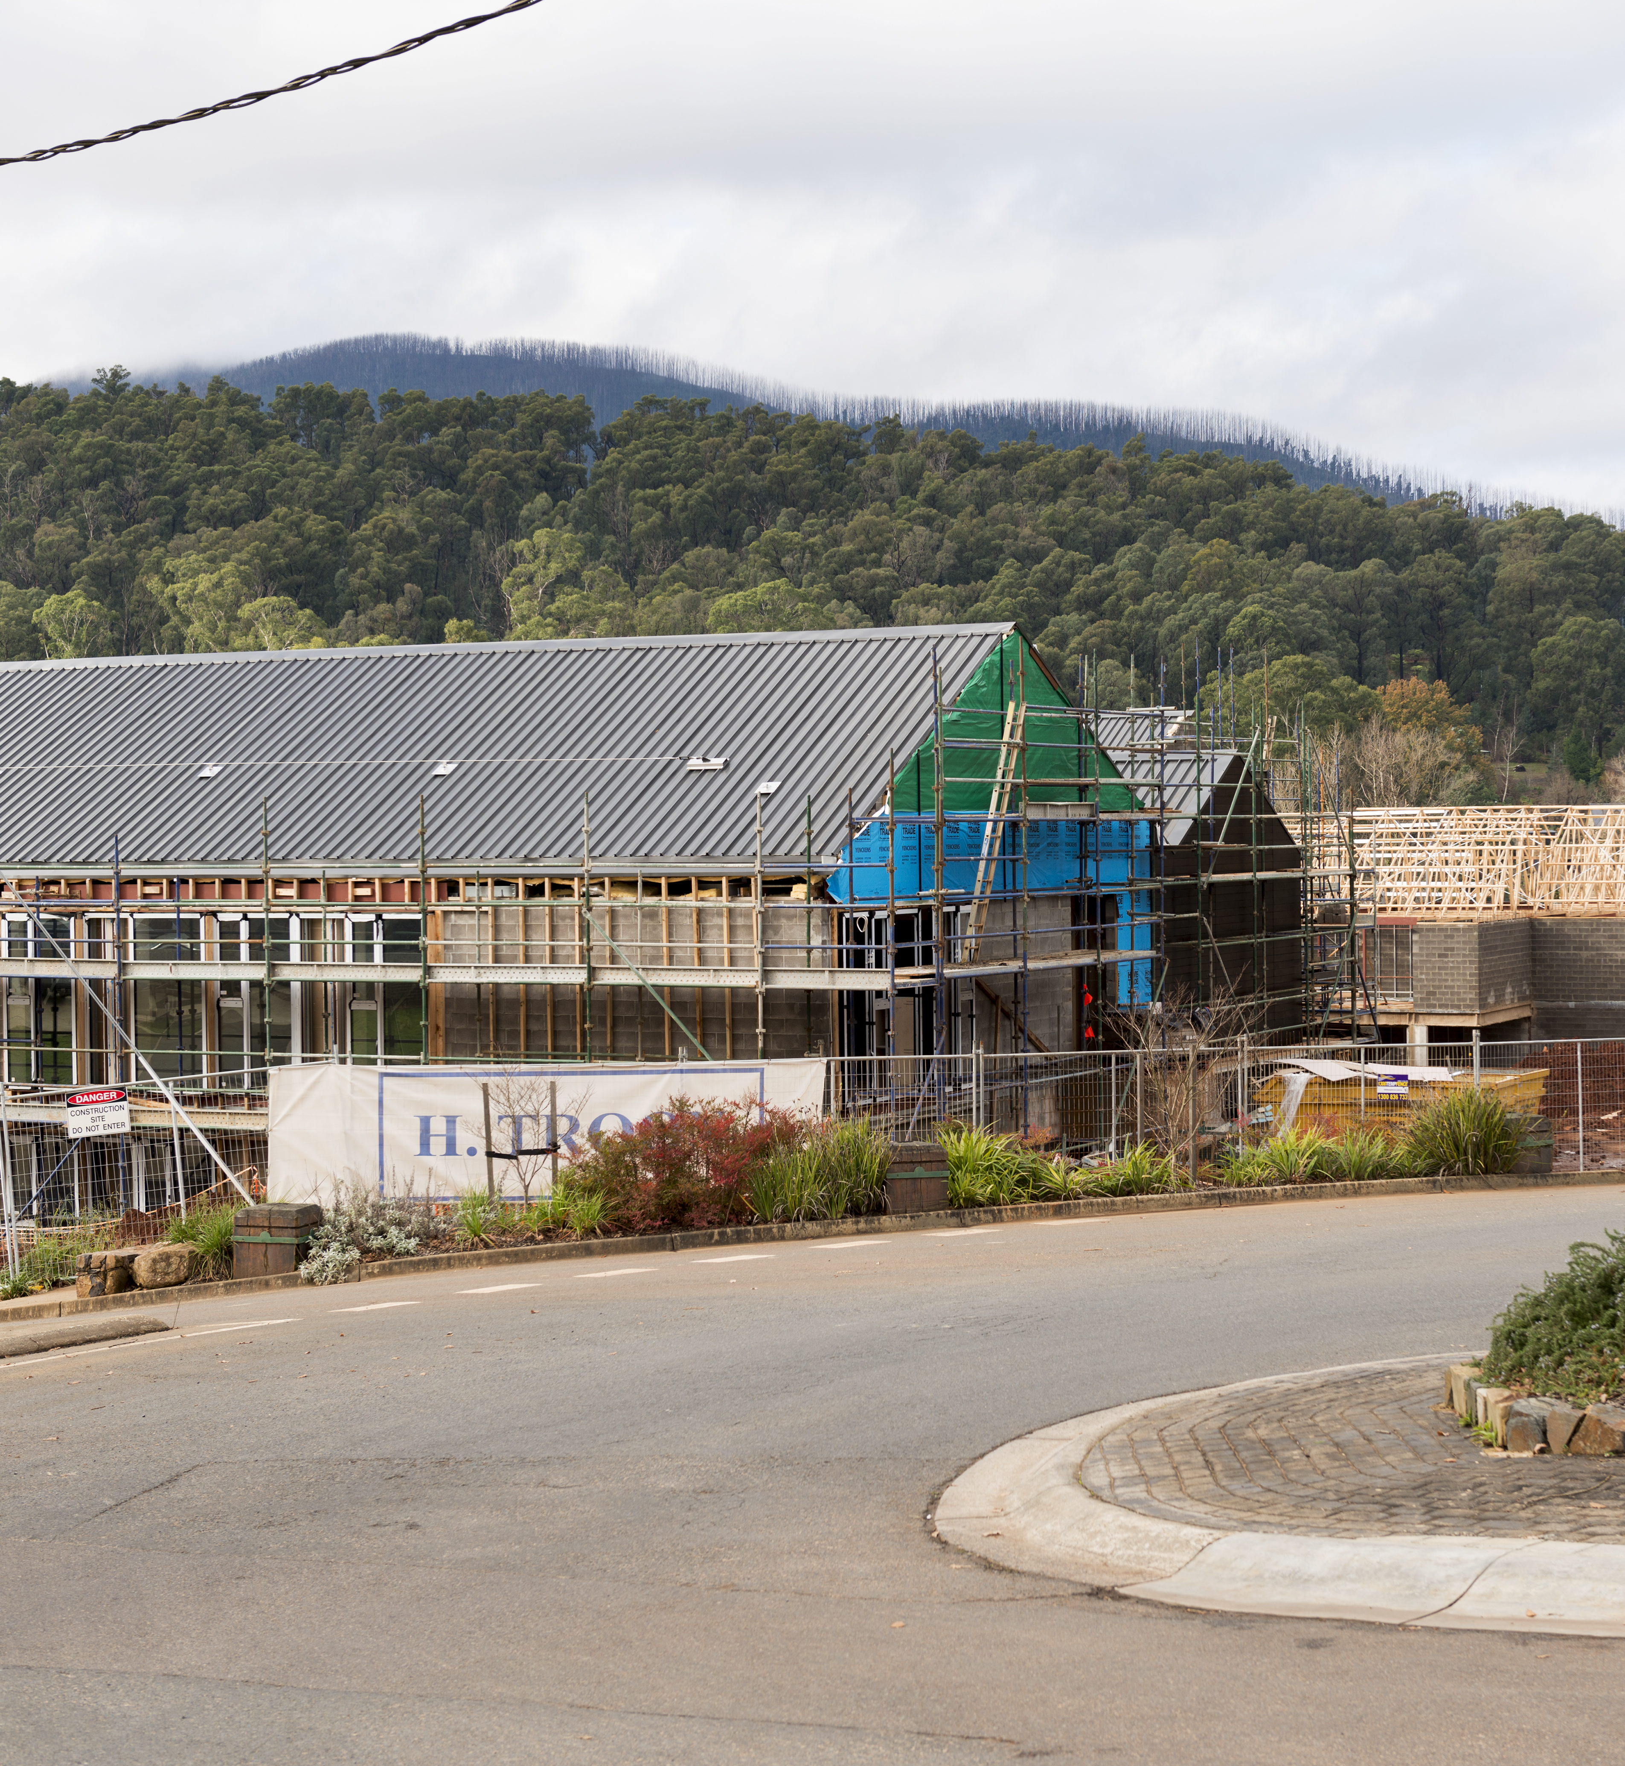
“Resilience starts from the belief that humans and nature are strongly coupled to the point that they should be conceived as one social-ecological system.
This means that in our globalised society, there are virtually no ecosystems that are not shaped by people and no people without the need for ecosystems and
the services they provide.”
(AIDR 2021, from Stockholm Resilience Centre 2019)
Notes:
We live in a time of uncertainty, where changes towards extremes are increasingly more obvious. In recent years, we have experienced a global pandemic, bushfires, droughts, floods, as well as intensive cyber-attacks. Disaster after disaster has highlighted Australia’s vulnerability to natural and non-natural threats and their social, environmental and economic impacts. Whilst there has been progress towards more resilience to natural hazards and in reducing disaster risk, with climate change
adding to the extremes and the compounding effects of several disasters combined, there is growing potential for events to occur at unimagined scales,
combinations and locations.

Slide 3
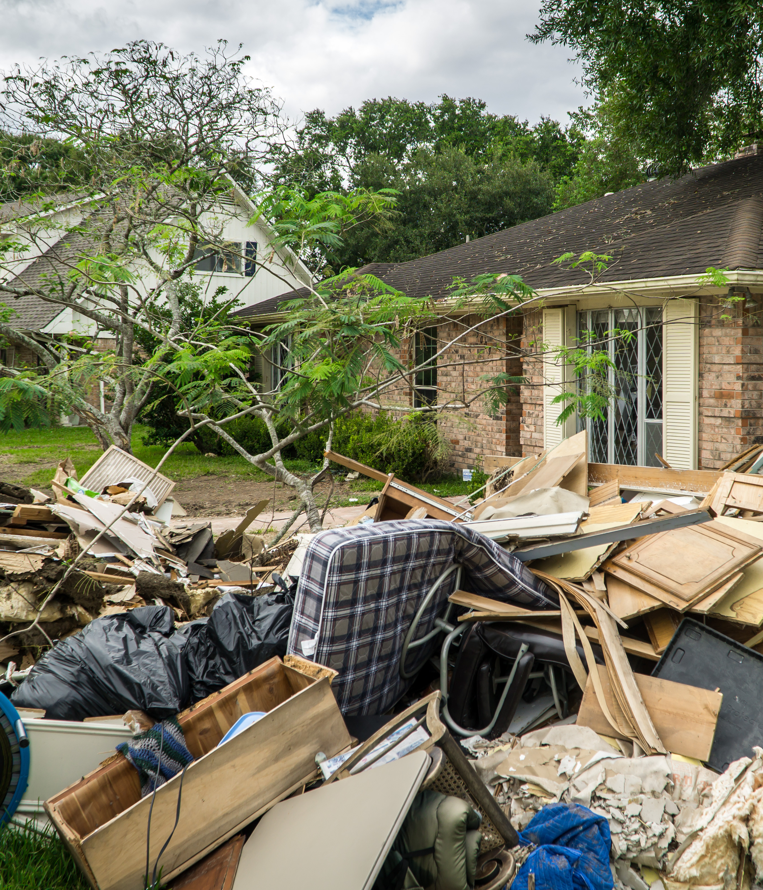
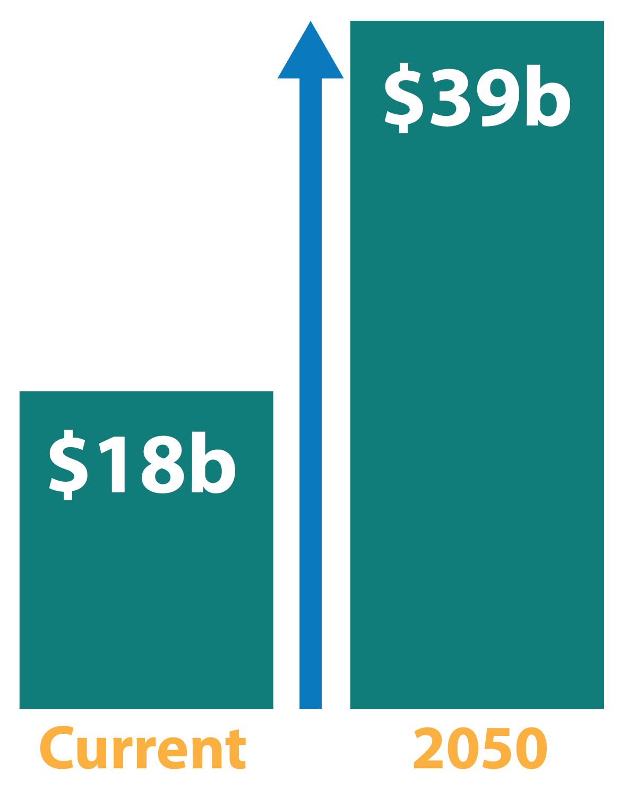
The cost of disasters to the Australian economy reached around $18 billion per year and could increase to $39 billion per year by 2050.
Notes:
Over the past ten years, the cost of disasters to the Australian economy reached around $18 billion per year and could increase to $39 billion per year by 2050. This cost does not account for less quantifiable costs of disasters, such as increased family violence, mental health impacts, chronic disease, alcohol and drug use, short and long-term unemployment, changes to school academic outcomes, and crime.
Further, it does not take into account the cost of climate change. It is estimated that unchecked climate change will reduce the size of the Australian economy by 6.3% by 2070, and lead to a net reduction of 880,000 jobs . However, aiming to limit global warming to 1.5 degrees and investing in climate adaptation measures is estimated to grow Australia’s economy by $680 billion in present day terms and add over 250,000 jobs by 2070.
While individuals and communities are crucial to building resilience, they do not have control over many of the essential services and critical infrastructure needed, nor the levers to pull to reduce some disaster risks. Governments and industry must take coordinated action to reduce risks within their control to limit adverse impacts on communities. Councils, in particular, have a duty of care to protect their community and environment. Resilience is high on the agenda, with new guidance, best practice and tools produced in the last years and more updates on their way to tackle a future of uncertainty and extremes.
Now is the time to act!

Slide 4
[Insert Council specific progress slides with work to date]
Notes:
Over the past ten years, the cost of disasters to the Australian economy reached around $18 billion per year and could increase to $39 billion per year by 2050. This cost does not account for less quantifiable costs of disasters, such as increased family violence, mental health impacts, chronic disease, alcohol and drug use, short and long-term unemployment, changes to school academic outcomes, and crime.
Further, it does not take into account the cost of climate change. It is estimated that unchecked climate change will reduce the size of the Australian economy by 6.3% by 2070, and lead to a net reduction of 880,000 jobs . However, aiming to limit global warming to 1.5 degrees and investing in climate adaptation measures is estimated to grow Australia’s economy by $680 billion in present day terms and add over 250,000 jobs by 2070.
While individuals and communities are crucial to building resilience, they do not have control over many of the essential services and critical infrastructure needed, nor the levers to pull to reduce some disaster risks. Governments and industry must take coordinated action to reduce risks within their control to limit adverse impacts on communities. Councils, in particular, have a duty of care to protect their community and environment. Resilience is high on the agenda, with new guidance, best practice and tools produced in the last years and more updates on their way to tackle a future of uncertainty and extremes.
Now is the time to act!

Slide 5
About Hunter JO’s Resilience IP&R Support Package
Notes:
Hunter JO prepared a support package for Councils to embed resilience as Business-as-Usual through the IP&R documents: Community Strategic Plan, Delivery Program and Operation Plan.
The package aims to:
Provide user friendly support for Councils
Leverage time, resources and avoid duplication of effort by providing templates in line with the latest science and guidance
Support the discussion between Council decision makers, IP&R staff, climate change staff and the community
Embed climate change as business as usual in the IP&R framework
Align with the IP&R Cycle
Brief overview of the climate change IP&R package as per figure on the slide.

Slide 6
Commitment Levels
Notes:
Hunter JO prepared a support package for Councils to embed resilience as Business-as-Usual through the IP&R documents: Community Strategic Plan, Delivery Program and Operation Plan.
The package aims to:
Provide user friendly support for Councils
Leverage time, resources and avoid duplication of effort by providing templates in line with the latest science and guidance
Support the discussion between Council decision makers, IP&R staff, climate change staff and the community
Embed climate change as business as usual in the IP&R framework
Align with the IP&R Cycle
Brief overview of the climate change IP&R package as per figure on the slide.

Slide 7
Councils’ Shared Responsibilities in Resilience
Notes:
[Note: The full descriptions for the shared responsibilities (including key concepts for achieving them) can be provided to participants by giving them the fact sheet in Appendix B of the Resilience IP&R Support Package]
Central to the Hunter JO support package are the categories of shared responsibilities, defined after an extensive literature review including guidelines and regulatory frameworks in Australia and internationally. For a holistic resilience strategy, all the categories should be addressed. The support package provides template wording for each area to ensure that the key concepts from available guidance to increase resilience are included.

Slide 8
Proposed Commitment Level
[Insert proposed commitment level AND / OR inclusions and commitments proposed for the IP&R documents]
Notes:
Discuss the proposed commitment level for your Council and the justifications, and / or the inclusions and commitments proposed for the IP&R documents.

Slide 9
Questions?
Notes:
Hunter JO prepared a support package for Councils to embed resilience as Business-as-Usual through the IP&R documents: Community Strategic Plan, Delivery Program and Operation Plan.
The package aims to:
Provide user friendly support for Councils
Leverage time, resources and avoid duplication of effort by providing templates in line with the latest science and guidance
Support the discussion between Council decision makers, IP&R staff, climate change staff and the community
Embed climate change as business as usual in the IP&R framework
Align with the IP&R Cycle
Brief overview of the climate change IP&R package as per figure on the slide.

